Slide 1
Chapter 17 Waves - II
  Sound Waves
  The Speed of Sound
  Traveling Sound Waves 4 Interference
  Intensity and Sound Level
  Sources of Musical Sound (Sound Waves Resonances) 7 The Doppler Effect

Slide 2
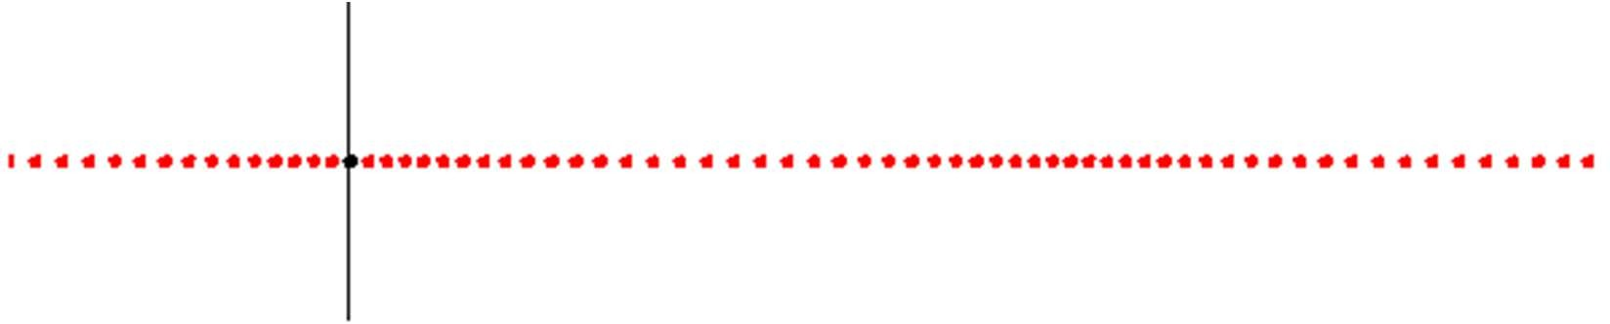
17-1 Sound Waves Introduction
Sound waves are
Mechanical waves
Need medium to travel Longitudinal waves
Oscillations are parallel to the direction of travel
Motion of the wave Motion of particles
We use sound waves to
Speak and listen
Probe Earth’s crust for oil Detect underwater objects Image fetuses

Slide 3
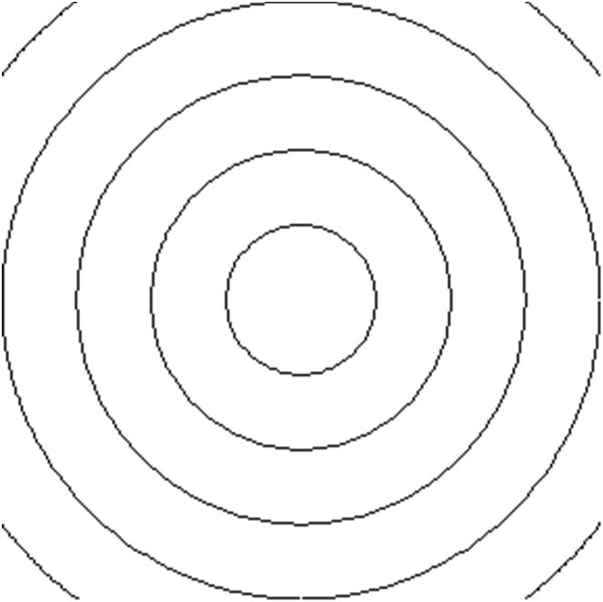
17-1 Sound Waves Definitions
A point source emits in all directions.
A wavefront is an imaginary surface over which the displacements of particles are the same.
Spherical waves
A ray is a directed line perpendicular to wavefronts and indicates the direction of travel of the wavefronts.
Away from a point source, we can approximate the wavefronts as planes.
Wavefronts
Ray
Planar waves are waves with planar wavefronts.
λ

Slide 4
17-2 The Speed of Sound Formula - Speed of Sound
Bulk modulus of the medium
Speed of sound
B
p
v =
Density of the medium

Slide 5
17-2 The Speed of Sound Bulk modulus
Bulk modulus
Change in pressure
_{B = –} ∆P
V
P
∆V / V
Original volume Change in volume
The bulk modulus
always positive
SI unit N/m² = Pascal (Pa)
_{V+∆V} P+∆P
The bulk modulus of a medium is the property that determines the change in volume of an element of the medium when the pressure on it changes.
A higher bulk modulus indicates a less compressible medium. Steel has higher bulk modulus than air.

Slide 6
17-2 The Speed of Sound
B
p
τ µ
Speed of sound
v =
v =
Speed of string wave
Medium | Speed (m/s)
Air(0⁰C) | 331
Air(20⁰C) | 343
Water(20⁰C) | 1482
Steel | 5941
Speed of sound depends on temperature and pressure

Slide 7


17-2 The Speed of Sound Example 1
A sound source which is very far such that wavefronts at ears are approximately planar.
q
Ear
Find an expression for the time delay ∆t between the arrival of the sound at the left and the right ears.
D
Solution
₌ Dsinq
Wavefronts
∆t = ^{d}
v v
d
From the time delay ∆t, your brain will find the direction of the source.
q
q
L
D
R

Slide 8
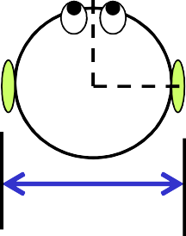

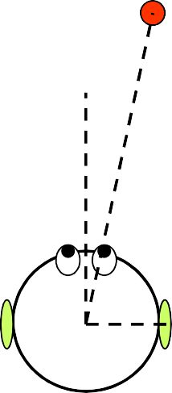

17-2 The Speed of Sound Example 2
Water
Suppose you are submerged in water at 20⁰C. Based on the time delay, at what angle from the forward direction does the source seem to be?
Ear
D
Solution
Apparent position
Dsin 90□
Dsinq
∆t =
=
v_{w}
v
sinq = ^{v} = ^{343 m / s} = 0.231 v_{w} 1482 m / s
q = 13□
Real position

Slide 9
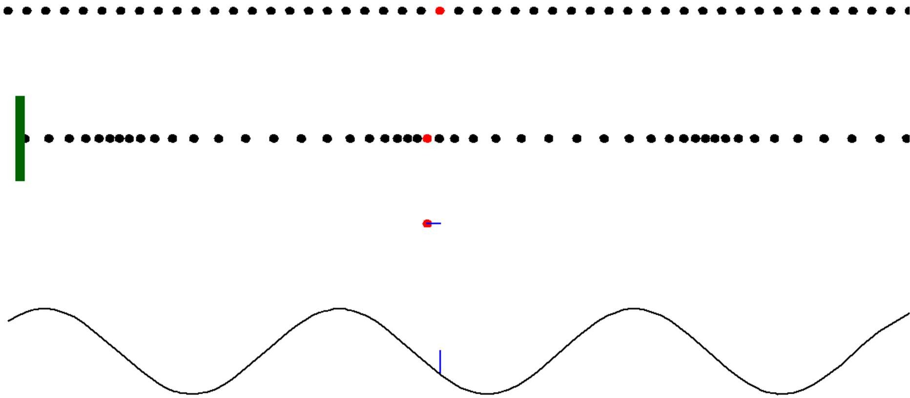
17-3 Traveling Sound Waves Displacement
No sound wave
Air particles
Sound wave
Piston
s(x,t)
s(x,t) Displacement from equilibrium
Displacement along x axis is represented along y axis.
Displacement
Displacement
s(x,t) = s_{m} cos(kx – wt + ф)
Displacement amplitude

Slide 10
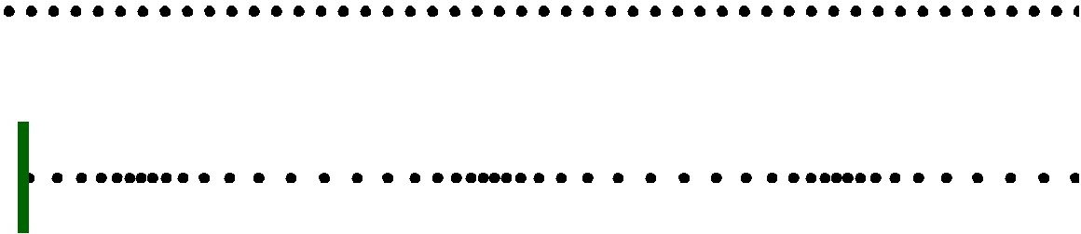
17-3 Traveling Sound Waves Pressure
Pressure is proportional to density
No sound wave
Sound wave
Piston
Lower density Lower pressure Expansion
Higher density Higher pressure Compression

Slide 11
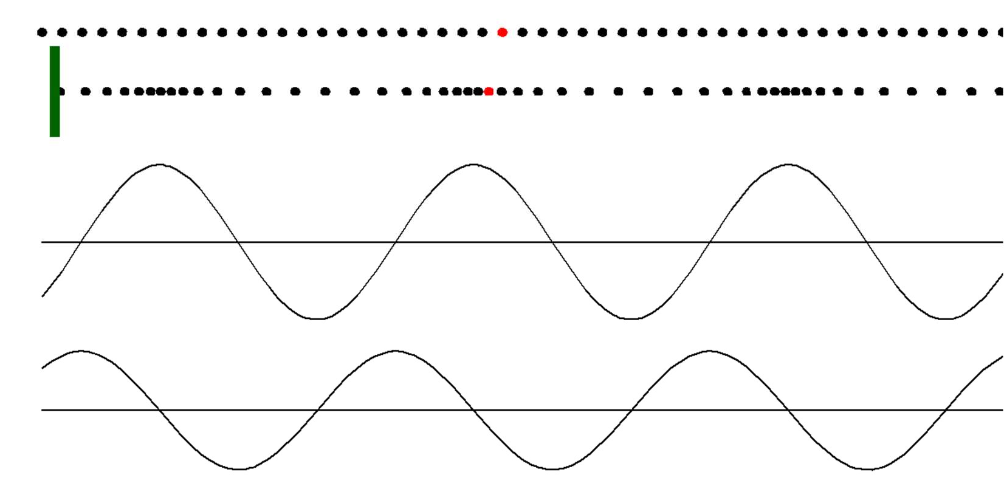
17-3 Traveling Sound Waves Displacement and pressure variation
∆p(x,t)
Pressure variation
s(x,t)
Displacement
Displacement s(x,t) and pressure variation ∆p(x,t) are π/2 out of phase.
s(x,t) = s_{m} cos(kx – wt + ф)
∆p(x, t) = ∆p_{m} sin(kx – wt + ф)
Pressure variation
Pressure amplitude

Slide 12
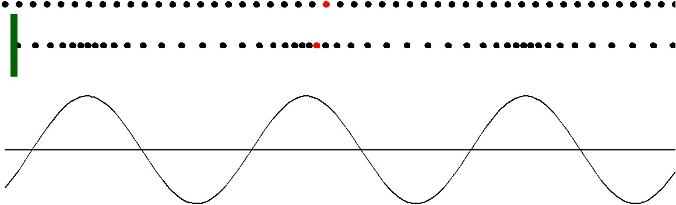
17-3 Traveling Sound Waves Displacement and pressure amplitudes
Positive ∆p. Compression. Pressure is higher than normal pressure.
Negative ∆p. Expansion.
Pressure is less than normal (atmospheric) pressure.
Pressure amplitude Density
∆p_{m} = (vpw)s_{m}
Displacement amplitude
∆p(x,t)
Pressure variation
Speed of sound
Angular frequency

Slide 13
17-3 Traveling Sound Waves Loudest and faintest sound
∆p_{m} = (vpx)s_{m}
At 1000 Hz and at room temperature
 | ∆p_{m} | s_{m}
Loudest sound you can tolerate | 30 Pa | 10 µm
Faintest sound you can hear | 30 µPa | 10 pm
 | Atmospheric pressure 10⁵ Pa | Wavelength 0.34 m
Human ears can hear sounds with frequencies between 20 Hz to 20 kHz. They are most sensitive for sounds with frequencies around 1000 Hz.
micro = 10⁻⁶
pico = 10⁻¹²

Slide 14
17-3 Traveling Sound Waves Example 3
The maximum pressure amplitude ∆p_{m} that the human ear can tolerate in loud sounds is about 28 Pa.
What is the displacement amplitude s_{m} for such a sound in air?
Density p = 1.21 kg/m³ Frequency =1000 Hz Sound speed = 343 m/s
Solution
∆p_{m} = (vpx)s_{m}
₌ ∆p_{m}
28Pa
s
=
m
vpw (343 m / s)(1.21kg / m³ )(2π)(1000Hz)
= 11 µm

Slide 15


17-4 Interference
Phase difference and path length difference
P
Wave 1
The distance between the point P and the sound sources L₁ and L₂ is much greater than the distance between the sources so that we can approximate the waves as traveling in the same direction at P.
L₁
Wave 2
L₂
S
1
S₂
Two point sources S₁ and S₂ emit sound waves that are in phase and of identical wavelength λ.
At point P
ф = ∆L( ^{2π})
λ
Phase difference
The two sources are in phase. between wave 1 and
wave 2
Path length difference
∆L= L -L
2 1

Slide 16
17-4 Interference
Constructive and destructive interference
P
Wave 1
ф = ∆L( ^{2π})
L
λ λ
1
Wave 2
∆L = ф( )
2π
L
2
S
1
At point P
S₂
Phase difference between wave 1 and wave 2
Path length difference
Constructive interference
Destructive interference
ф = n(2π)
ф = (2n + 1)π
∆L = nλ
∆L = (n + 1) ^{λ}
2
The two waves are out of phase
The two waves are in phase
for n = 0,1,2,...

Slide 17
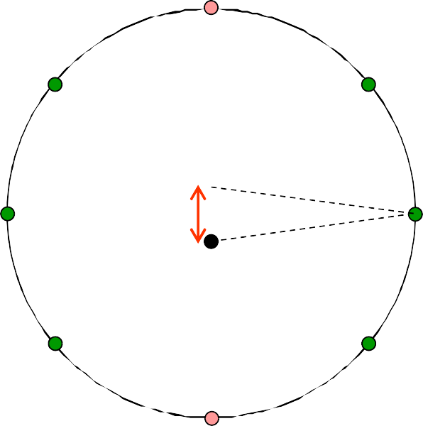
17-4 Interference
Example 4
Two point sources S₁ and S₂,which are in phase and separated by a distance D = 1.5 λ, emit sound waves of identical wavelength λ.
What kind of interference at point P₁?
What kind of interference at point P₂?
What is the number of points on the circle at which the interference is fully constructive?
Solution
∆L=1.5λ
At point P₁, ∆L=L₂-L₁=0. The interference is fully constructive at P₁.
At point P₂, ∆L=L₂-L₁=1.5λ. The interference is fully destructive at P₂.
There are six points on the circle where the interference is fully constructive.
P₂
∆L=1.0λ
∆L=1.0λ
S
1
∆L=0λ
D=1.5λ
P
1
∆L=0λ
S₂
∆L=1.0λ
∆L=1.0λ
∆L=1.5λ

Slide 18
17-4 Interference
Checkpoint 2
In previous sample problem, if D = 4 λ
What would occur at point P₁?
What would occur at point P₂?
Solution
At point P₁, ∆L=L₂-L₁=0. The interference is fully constructive at P₁.
At point P₂, ∆L=L₂-L₁=4.0λ. The interference is fully constructive at P₂.
∆L=4λ
P₂
S₁
D=4λ
P₁
∆L=0λ
S₂

Slide 19
17-5 Intensity and Sound Level Formula
The intensity I of a sound wave at a surface is the average rate per unit area at which energy is transferred by the wave into the surface
Intensity
Average Power
Surface with area A
P
I =
avg
Energy transmitted in one period
A
Area Intensity SI unit is
W/m²
Sound
Angular frequency P
₌ Energy trasferred in one period
Intensity
avg
One period
I = ¹ pvx²s²
2
m
Displacement amplitude Speed of sound
Density of the medium
For string waves
P = ¹ µvx² y²
ave
2
m

Slide 20
17-5 Intensity and Sound Level Intensity of a point source
For a real source, the intensity varies, often in a complex way, with the distance from the source.
For a point source, the sound is emitted isotropically, that is with equal intensity in all directions. In this case, the intensity can be found easily.
_{I =} ^{P}avg
All energy emitted by the source must pass through the sphere.
A
Intensity
Power of the source
P_{s}
I =
r
4πr²
Power of the source P_{S}
Distance from the point source
S
The intensity of sound from isotropic point source decreases with the square of the distance from the source.
Imaginary Sphere

Slide 21
17-5 Intensity and Sound Level Checkpoint 3
The three patches receive the same energy. 3
Rank them, greatest first, according to
the intensity of sound on them, and
their area.
S
2
1
Imaginary Spheres
Solution
Intensity
1 and 2 tie
3
Area 3
1 and 2 tie
P_{s} 4πr²
_{I =} ^{P}avg
I =
A

Slide 22
17-5 Intensity and Sound Level Sound level
Sound level
Intensity
β = (10dB)log ^{I}
I₀
Unit to measure sound level dB = decibell
I =10⁻¹² W/m²
0
Reference intensity
(lowest you can hear)
Deci Bell
related to 10 Alexander Graham Bell
At 1000 Hz and at room temperature | ∆p_{m} Pressure Amplitude | s_{m} Displacement Amplitude | I Intensity | β Sound level
Loudest sound you can tolerate | 30 Pa | 10 µm | 1 W/m² | 120 dB
Faintest sound you can hear | 30 µPa | 10 pm | 10⁻¹² W/m² | 0 dB
β is a simpler way to express intensity

Slide 23
17-5 Intensity and Sound Level Example 5
An electric spark of length L = 10 m emits a pulse of sound radially outward. The power of the emission is P_{s} = 1.6 x 10⁴ W.
What is the intensity of the sound at a distance r = 12 m from the spark?
At what rate P_{d} is sound energy intercepted by a detector of area A_{d} = 2.0 cm² and located at r = 12 m?
Solution
Linear sound source (spark)
P_{s}
A 2πrL
All energy emitted by the source must pass radially through the cylinder.
(a) I = ^{P} =
1.6 ×10⁴ W
=
= 21 W / m
2
2π(12m)(10 m)
P
L
Detector Area A_{d}
(b)
_{I =} d
A_{d}
P = IA = (21W / m² )(2.0 ×10^{–4} m² ) = 4.2mW
d d
r

Slide 24
17-5 Intensity and Sound Level Example 6
Two sources with sound levels β₁ = 92 dB and β₂ = 120 dB. What is the ratio of their intensities?
Solution
β = (10dB)log ^{I}
I₀
β
I I₀
= log
10
β
₁₀10
I I₀
=
β
I = I₀10¹⁰
β₂
I
I 10¹⁰
β_{2 –} β₁
2 ₌ 0
= 10¹⁰
10
= 10^{12–9.2} = 630
I
β₁
I 10¹⁰
1
0

Slide 25
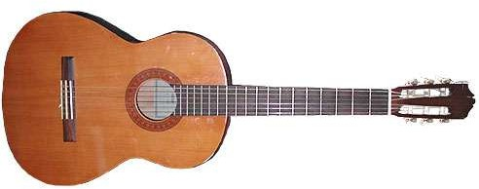
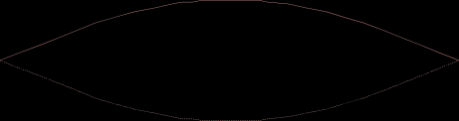



17-6 Sources of Musical Sound (Sound Waves Resonances) Air columns
Musical sounds are produced by resonances of different oscillating bodies
Strings
At resonant frequencies, the string oscillates with large amplitudes pushing against the surrounding air and generating a noticeable sound.
Membranes
Air columns
At certain frequencies, reflections at both ends set up oscillating modes in the air column
Pipes with two open ends
Pipes with one open end
Resonant frequencies

Slide 26
17-6 Sources of Musical Sound (Sound Waves Resonances) Pipes with two open ends
Pipes with two open ends
At an open end, there is some reflection. The reflection is not complete.
Sound source
After the 1st reflection from the right end
After the 1st reflection
from the left end
After the 2nd reflection
from the right end
At resonance, the right-going waves are in phase as well as the left-going waves.

Slide 27
17-6 Sources of Musical Sound (Sound Waves Resonances) Pipes with one open end
Pipes with one open end
At the closed end, the wave is reflected back and it is inverted.
Sound source
After the 1st reflection from the closed end
After the 1st reflection
from the open end
After the 2nd reflection from
the closed end
At resonance, the right-going waves are in phase as well as the left-going waves.

Slide 28
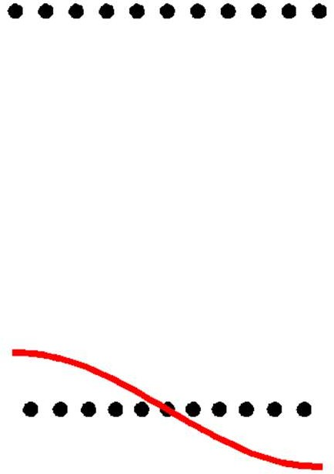
17-6 Sources of Musical Sound (Sound Waves Resonances) Standing waves in pipes with one open end
No wave
An open end of a pipe is like the end of a string attached to a freely moving ring. A wave is not inverted upon reflection from an open end. Nodes cannot occur at open ends.
Air particles
Pipe
Standing wave
s(x,t)
Displacement
At resonance, there must be an antinode at the open ends.
Representing a standing sound wave in a pipe.

Slide 29
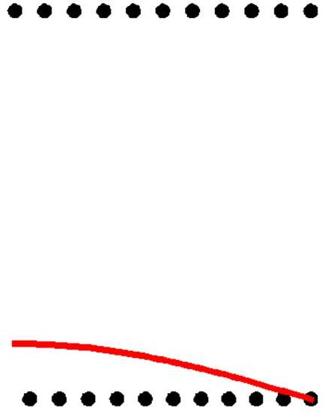
17-6 Sources of Musical Sound (Sound Waves Resonances) Standing waves in pipes with two open ends
No wave
A closed end of a pipe is like the end of a string attached to a fixed point. A wave is inverted upon reflection from a closed end. Air cannot move back and forth and the displacement is always zero at closed ends.
Air particles
Pipe
Standing wave
s(x,t)
Displacement
At resonance, there must be an antinode at the open end and
a node at the closed end.
Representing a standing sound wave in a pipe.

Slide 30
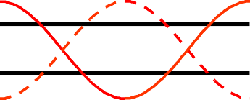
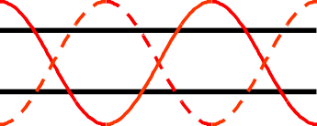
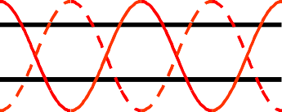
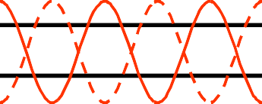
17-6 Sources of Musical Sound (Sound Waves Resonances) Oscillation modes
Harmonic number
Oscillation mode
Oscillation mode
L
L
Fundamental _{λ =} ^{2L}
1st harmonic 1
f = 1 ^{v}
_{λ =} 4L
f = 1 ^{v}
n =1
2L
1
4L
n =2
2nd harmonic λ = ^{2L}
f = 2 ^{v}
Missing
2
2L
n =3
_{λ =} 2L
_{λ =} 4L
3rd harmonic
f = 3 ^{v}
f = 3 ^{v}
3
2L
3
4L
n =4 4th harmonic ^{λ = 2L}
f = 4 ^{v}
Missing
4
2L
_{λ =} 4L
n =5
5th harmonic λ = ^{2L}
f = 5 ^{v}
f = 5 ^{v}
5
2L
5
4L
_{λ =} 2L
_{λ =} 4L
n = odd
integer
n^{th} harmonic
n = integer
f = n ^{v}
f = n ^{v}
n
2L
n
4L

Slide 31
17-6 Sources of Musical Sound (Sound Waves Resonances) Resonant frequencies of pipes with two open ends
The distance between two
consecutive left-going waves is 2L
For constructive interference, the phase difference between the two waves is
phase difference = n 2π rad
= n λ
After 3rd reflection from the right end
for
Resonance occurs when
n = 1,2,...
2L = nλ
After 4th reflection from the right end
_{λ =} 2L
n
f = ^{v}
Round trip distance = 2L
λ
Resonant frequencies
f = n ^{v}
2L
for n = 1,2,...

Slide 32
17-6 Sources of Musical Sound (Sound Waves Resonances) Resonant frequencies of pipes with one open end
The distance between two
λ
2
consecutive left-going waves is 2L +
For constructive interference, the phase difference between the two waves is
phase difference = n 2π rad
= n λ
After 3rd reflection from the right end
After 4th reflection from the right end
for n = 1,2,...
Resonance occurs when
λ
2L + = n λ
2
4L ₌ 4L
2n – 1 n
λ =
for n = odd int eger
At the closed end, the wave will be inverted. To do this, the wave moves an extra half wavelength.
f = ^{v}
λ
Resonant frequencies f = n ^{v}
4L
Round trip distance = 2L + ^{λ}
2
for n = odd int eger

Slide 33
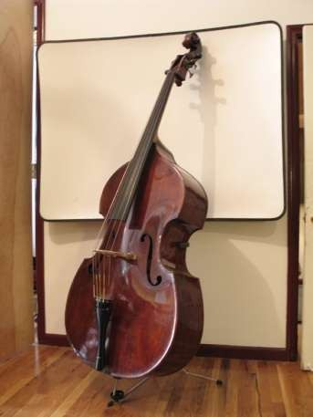
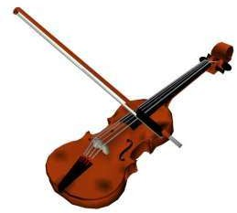
17-6 Sources of Musical Sound (Sound Waves Resonances) Size and resonant frequency
When a musical instrument is played, the fundamental and one or more higher harmonics are generated at the same time
Resonant frequencies f = n ^{v}
2L
To produce low frequency sounds, you need to use larger musical instruments.
Violin
High frequency
Brass
Low frequency

Slide 34
17-6 Sources of Musical Sound (Sound Waves Resonances) Checkpoint 4
Which harmonic of pipe B has the same frequency of the fundamental of pipe A?
Pipe A
Pipe B
L_{A}
2 L_{A}
f = fundamental
f = which harmonic?
Solution
The second harmonic
f = n ^{v}
2L
v
f = 1
2L_{A}
Pipe A
v
Pipe B
f = 2
2(2L_{A} )

Slide 35

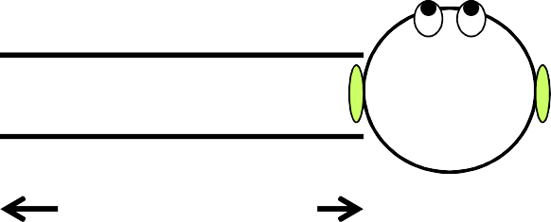
17-6 Sources of Musical Sound (Sound Waves Resonances) Example 7
Background noises from a room setup the fundamental standing wave in a cardboard.
Use speed of sound 343 m/s.
cardboard tube
What frequency do you hear?
L =67.0 cm
Solution
f = n ^{v}
₌ ₁ 343 m / s
= 256Hz
2L
2(0.670m)
cardboard tube
If you jam your ear against one end, what fundamental frequency do you hear?
L =67.0 cm
Solution
The tube is closed from one end
₌ ₁ 343m / s
f = n ^{v}
= 128Hz
4L
4(0.670m)

Slide 36
17-7 The Doppler Effect Definition
The Doppler effect is the change in the detected frequency because of a relative motion between the source of sound and the detector.
Source of sound Siren Loudspeaker
Detector of sound Ear Microphone
S
f
v_{s}
Speed of the source
D
f'
v_{D}
Speed of the detector
Frequency emitted by the source
Frequency detected by the detector
v_{S} and v_{D} are measured relative to the air. If air is stationary, these will be the same as that measured relative to the ground.

Slide 37
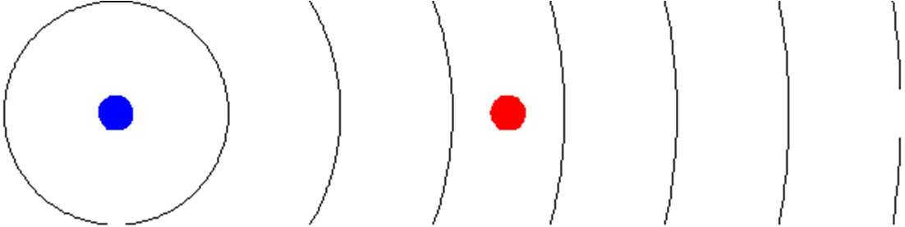
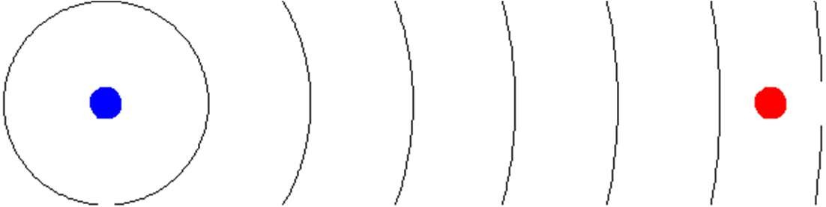
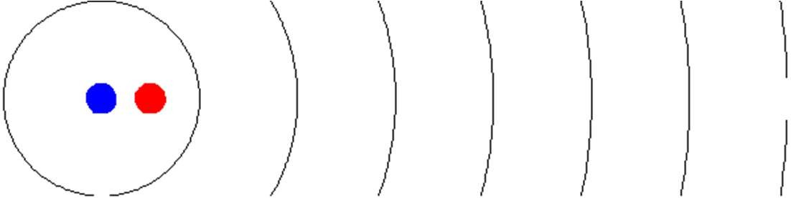
17-7 The Doppler Effect Moving detector
Detector intercepts f wavefronts per second
f' = f
Detector intercepts more than f wavefronts per second
f' > f
Detector intercepts less than f wavefronts per second
f' < f

Slide 38



17-7 The Doppler Effect Moving source
Detector intercepts f wavefronts per second
f' = f
Detector intercepts more than f wavefronts per second
f' > f
Detector intercepts less than f wavefronts per second
f' < f

Slide 39
17-7 The Doppler Effect Relative motion and frequency
f
S
f'
D
v_{D}
f' < f
f
S
f'
D
v_{D}
f' > f
f
S
f'
D
v_{S}
f' > f
f
S
f'
D
v_{S}
f' < f
When they move towards each other, the frequency is shifted up. When they move away form each other, the frequency is shifted down.

Slide 40
17-7 The Doppler Effect Formula
Frequency at detector
Frequency at source
Speed of detector
_{f' = f} v ± v_{D}
v ± v_{S}
Speed of source
Speed of sound
Choose the signs such that when the source and detector move towards each other you get higher frequency, and when they move away from each other you get lower frequency

Slide 41
17-7 The Doppler Effect Choosing the correct signs
_{f' = f} v – v_{D}
Detector moves away from the source
v ± v_{S}
_{f' = f} v + v_{D}
Detector moves towards the source
v ± v_{S}
_{f' = f} v ± v_{D}
Source moves towards the detector
v – v_{S f' = f} v ± v_{D}
Source moves away from the detector
v + v_{S}
Choose the signs such that when the source and detector move towards each other you get higher frequency, and when they move away from each other you get lower frequency

Slide 42
17-7 The Doppler Effect Checkpoint 5
Solution
Is the detected frequency greater than or less than the emitted frequency, or can’t we tell without more information about the actual speeds?
v ± v
f' = f ^{D}
v ± v_{S}
Source
Detector
0 speed
(a)
(a) greater
f' = f
v
v – v_{S} v
(b)
0 speed
(b) less
f' = f
v + v_{S}
(c)
(c) cannot tell
_{f' = f} v – v_{D}
v – v_{S}
(d)
(d) cannot tell
_{f' = f} v + v_{D}
v + v_{S}
(e)
(e) greater
f' = f ^{v + vD}
v – v_{S}
(f)
(f) less
_{f' = f} v – v_{D}
v + v_{S}

Slide 43
17-7 The Doppler Effect Example 8
Detector
Rocket
Pole
Speed = 242 m/s.
Emitting sound waves at frequency f = 1250 Hz
What frequency f′ is measured by the detector? Solution
_{f' = f} v ± v_{D}
_{= f} v ± 0
v ± v_{S}
v – v_{S}
343 m / s
= (1250 Hz)
= 4250 Hz
343 m / s – 242 m / s

Slide 44
17-7 The Doppler Effect Example 9
Detector
Rocket
Pole
Speed = 242 m/s.
Echo Sound reflected from the pole
What frequency f′′ does a detector on the rocket detect for the echo?
Solution
_{f'' = f'} v ± v_{D = f'} v + v_{D}
v ± v_{S} v ± 0
= (4250 Hz) ^{343 m / s + 242 m / s} = 7420 Hz
343 m / s

Slide 45
17-7 The Doppler Effect Example 10
Rocket
Pole
Air speed = 20 m/s
Speed = 242 m/s.
In the two previous examples,
What value of the source speed v_{S} should be used? What value of the detector speed v_{D} should be used?
Solution
v_{S} and v_{D} is measured relative to the air. This is the speed of the rocket relative to the air.
v_{S} = 242 m/s – 20 m/s = 222 m/s. v_{D} = 242 m/s – 20 m/s = 222 m/s.

